Slide 1


Slide 2


Project Title
Second Year Project Synopsis
Submitted by
ROLL | NAME
2301730264 | LUV SACHWANI
2301730227 | HARSHIT BISHT
2301730240 | AMAN VASHIST
Industry Mentor: Mr. Anil Kumar Vashist
Faculty Mentor: Ms. Neetu Chauhan
Notes:
New Courses replaced with New Programmes

Slide 3

Project Overview
Brief Overview of the Topic
Freelance AI is an innovative application designed to transform how freelancers discover job opportunities. At its core, the app features a sleek and intuitive swipe-based interface—users simply swipe right to accept a job listing or left to decline. This minimal and interactive design mirrors the simplicity of dating apps but is tailored specifically for professional freelancing. The goal is to streamline the job-search process, making it less overwhelming and more engaging, especially for freelancers who manage multiple gigs or have limited time to browse platforms manually.
Notes:
New Courses replaced with New Programmes

Slide 4
Project Overview
AI-Powered Personalization & Benefits
What sets Freelance AI apart is its use of advanced artificial intelligence to personalize each user's experience. By analyzing user data such as skill sets, behavioral patterns, past interactions, and preferences, the app continuously learns and adapts to offer more accurate job matches over time. This results in higher-quality recommendations that align with the user’s strengths and interests. Freelancers benefit from faster job discovery, reduced search fatigue, and better alignment with projects that match their capabilities. Overall, Freelance AI empowers users with smart technology to maximize their freelance potential in an increasingly competitive digital landscape.
Notes:
New Courses replaced with New Programmes

Slide 5
Problems Identified
While Freelance AI introduces a modern and engaging approach to job discovery, several potential issues were identified during development and user testing. One key concern is the oversimplification of the decision-making process through the swipe-based interface. Unlike casual platforms such as dating apps, freelance job selection involves careful consideration of multiple critical factors—including the client's credibility, payment structure, scope of work, required deadlines, and the overall professional relevance of the opportunity.
Notes:
New Courses replaced with New Programmes

Slide 6
Problems Identified
This simplified interface might encourage users to make snap decisions without fully reviewing job details. As a result, valuable opportunities could be missed by swiping left too quickly. On the other hand, swiping right impulsively may lead to accepting low-quality or mismatched projects that don't align with the freelancer’s expertise or goals. Additionally, some users may feel the lack of in-depth filters or detailed previews limits their ability to make informed choices. This highlights the need to strike a balance between ease of use and access to essential information in future iterations of the platform.
Notes:
New Courses replaced with New Programmes

Slide 7
Issues or Problems
One major issue with swipe-based job matching is the oversimplification of decision-making, as freelancers need more than just a quick left-or-right swipe to evaluate opportunities. Without detailed job previews, they may miss out on valuable gigs or accept unsuitable ones due to a lack of context on factors like client credibility, payment terms, and workload. Additionally, the lack of an undo feature can lead to frustration if a freelancer accidentally dismisses a good opportunity. AI-driven matching also poses challenges, as incorrect swipes might mislead the algorithm, resulting in irrelevant recommendations over time. Lastly, job quality control is crucial—without proper filtering, freelancers may encounter low-paying or scam offers, reducing the platform’s effectiveness. Addressing these issues will be key to making Freelance AI a reliable and efficient tool for freelancers.
Notes:
New Courses replaced with New Programmes

Slide 8
About the Problem
Freelancers face unique challenges when searching for suitable job opportunities. Unlike casual swiping apps, freelance platforms must support thoughtful decision-making, as each project involves multiple factors—such as client trustworthiness, payment security, project complexity, and workload clarity. These elements are essential for maintaining a stable and productive freelance career.
However, if the platform only offers a simple swipe-based "yes" or "no" system, users are likely to encounter significant limitations. For example, important project details may be overlooked, leading to the rejection of promising jobs or the acceptance of poorly matched gigs. Without adequate context, freelancers may fall into traps like underpaid work, unclear expectations, or wasting time manually sorting through unsuitable offers. This friction ultimately reduces the platform's efficiency and can discourage long-term user engagement. .
Notes:
New Courses replaced with New Programmes

Slide 9
Existing Solution
Freelance Job Matching Solutions
Traditional Platforms (Upwork, Fiverr): Manual browsing & applications; competitive & time-consuming.
AI-Driven Platforms (LinkedIn, Deel): Skill-based recommendations but lack real-time engagement.
Gig-Swiping Apps (JobSwipe, Shapr for Work): Fast, interactive swiping but limited job details & no undo feature.
Freelance AI: A Hybrid Solution
Combines swipe-based simplicity with AI precision.
Provides detailed job insights before swiping.
Offers an undo feature to recover missed opportunities.
Ensures efficient, high-quality gig matching for freelancers.
Notes:
New Courses replaced with New Programmes

Slide 10
Problem Statement
Freelancers often struggle with inefficient job discovery, as existing platforms are either too time-consuming (manual browsing and bidding) or too simplistic (swipe-based apps lacking context). This leads to missed opportunities, wasted time, and irrelevant job matches due to the absence of detailed job previews, an undo feature, and precise AI-driven recommendations. Addressing this issue is crucial because freelancers rely on steady work for financial stability, and ineffective job-matching systems can result in lost income and reduced engagement. By refining Freelance AI to integrate comprehensive job insights, an undo option, and smarter AI recommendations, freelancers can secure better opportunities faster, enhancing their workflow, income stability, and overall satisfaction while positioning the app as a top-tier job discovery platform.
Notes:
New Courses replaced with New Programmes

Slide 11
Objectives
The main objective of Freelance AI is to streamline and enhance the job discovery process for freelancers by providing a fast, intelligent, and user-friendly platform. The goal is to combine the simplicity of swipe-based navigation with AI-driven precision, ensuring that freelancers receive highly relevant job opportunities while avoiding mismatches and missed chances. By integrating detailed job previews, an undo feature, and smarter recommendations, the platform aims to improve efficiency, reduce job-hunting frustration, and increase successful matches. Ultimately, Freelance AI seeks to empower freelancers by making job discovery seamless, time-efficient, and rewarding, helping them secure better gigs with minimal effort.
Notes:
New Courses replaced with New Programmes

Slide 12
Methodology, Tools, and Techniques
Freelance AI – A Hybrid Approach to Job Matching
Freelance AI is designed to enhance the freelance job-matching experience by combining AI-driven recommendations, user behavior analysis, and an intuitive swipe-based interface. Traditional job platforms often require freelancers to manually search and apply for roles, which can be both time-consuming and competitive. Meanwhile, AI-driven platforms provide job suggestions but lack real-time engagement. Swipe-based gig apps offer a fast and interactive experience, but often miss key job details and the ability to revisit past swipes.
This hybrid approach ensures an optimized experience where freelancers not only receive tailored recommendations but also gain deeper insights into job postings before making a selection. By incorporating intelligent filtering and personalized suggestions, Freelance AI streamlines the process, making it faster and more efficient without sacrificing accuracy.
Notes:
New Courses replaced with New Programmes

Slide 13
Methodology, Tools, and Techniques
Tools & Techniques Powering Freelance AI
Freelance AI leverages a robust tech stack to enhance job-matching precision. React Native ensures seamless cross-platform development, while Firebase enables real-time data management. OpenAI’s GPT models generate intelligent job descriptions, improving clarity in listings.
To refine job recommendations, the app incorporates collaborative filtering for personalized suggestions and deep learning for pattern recognition. Natural Language Processing (NLP) extracts key details from job postings for accurate matches. A well-optimized UX/UI design ensures freelancers have an intuitive, engaging experience.
This combination of tools and AI techniques guarantees fast, relevant, and user-friendly job discovery.
Notes:
New Courses replaced with New Programmes

Slide 14
Methodology Flowchart
PROFILE
SETUP
START
END
PROFILE
SETUP
JOBS
FEEDBACK
AI JOB
MATCHING
JOB
APPLICAION
NO
AI LEARNING
SWIPE
SELECTION
RECRUIT
Notes:
New Courses replaced with New Programmes

Slide 15
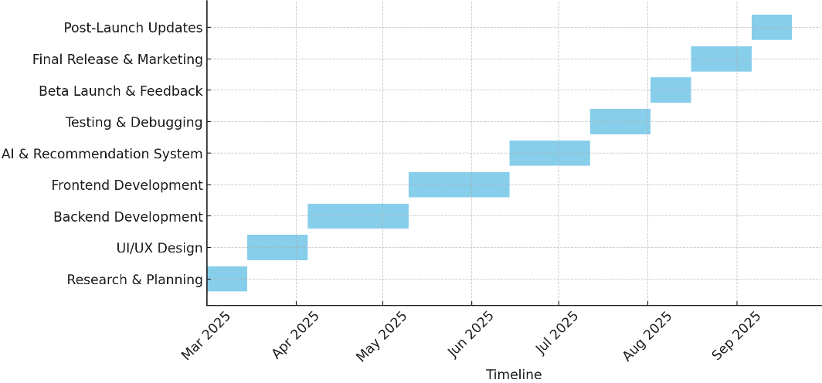
Project Timeline
Notes:
New Courses replaced with New Programmes

Slide 16
Expected Results & Impact
Freelance AI – The Future of Job Matching
Freelance AI streamlines job discovery by integrating AI-powered recommendations, user behavior analysis, and an intuitive swipe-based interface, reducing job search time and improving hiring success rates.
The fully developed website, with both front-end (React Native) and back-end (Firebase), ensures real-time job updates, seamless interactions, and an optimized user experience. OpenAI’s GPT models enhance job descriptions, while collaborative filtering, deep learning, and Natural Language Processing (NLP) refine job-matching accuracy.
Freelance AI benefits freelancers with personalized job matches, recruiters with better candidate selection, and researchers with insights into AI-driven job trends. Future expansions include enhanced AI personalization, premium features, and freelancer networking, positioning Freelance AI as a game-changer
Notes:
New Courses replaced with New Programmes

Slide 17
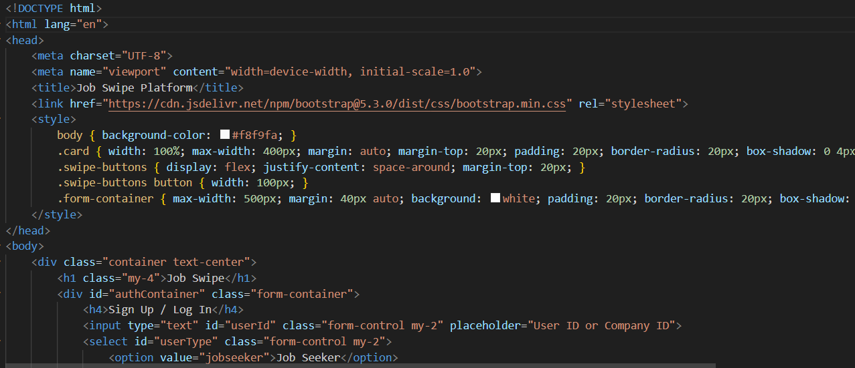
Frontend Code Snippets -
Notes:
New Courses replaced with New Programmes

Slide 18
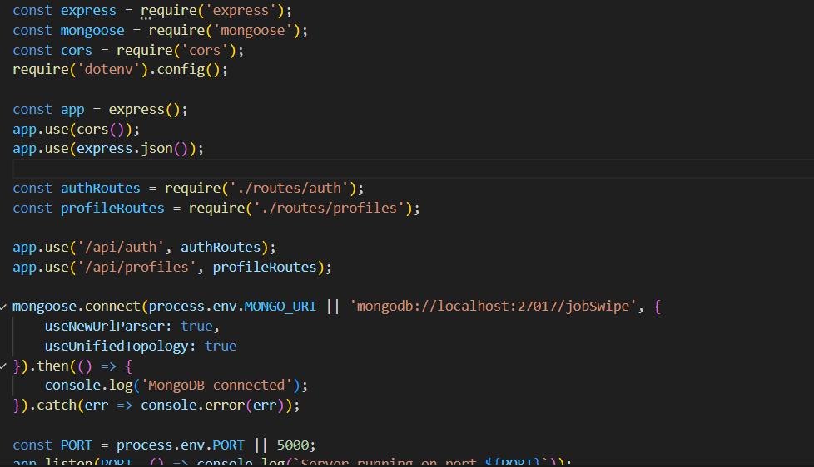
Backend Code Snippets-
Notes:
New Courses replaced with New Programmes

Slide 19
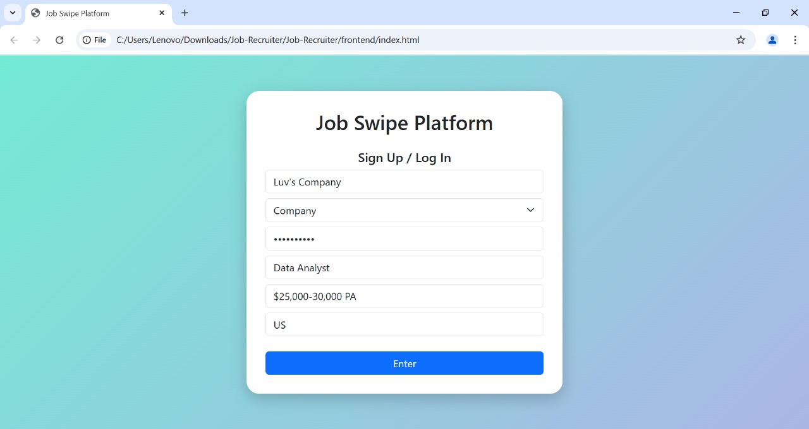
UI / UX SNIPPETS
Notes:
New Courses replaced with New Programmes

Slide 20
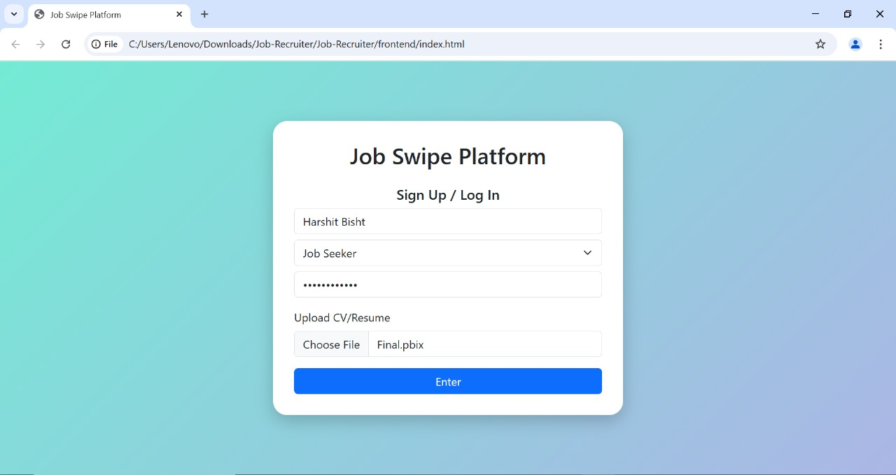
UI/UX SNIPPETS -
Notes:
New Courses replaced with New Programmes

Slide 21
References
Research Papers:
Braesemann & del Rio-Chanona (2025). Generative AI in Freelance Markets.
Rodrigues & Chavez (2022). AI Job Matching.
Bastian & Munoz (2023). AI in Recruitment.
Books:
Christian (2025). The Alignment Problem.
Surma (2023). Hacking AI.
Buolamwini (2025). Unmasking AI.
Websites:
Restackio (2025). Best AI Books.
Stratoflow (2025). Top AI Recommender Systems.
CSH (2025). AI & Freelance Market.
Notes:
New Courses replaced with New Programmes

Slide 22
THANK YOU

